Slide 1
Supervised Learning
Manaranjan Pradhan

Slide 2
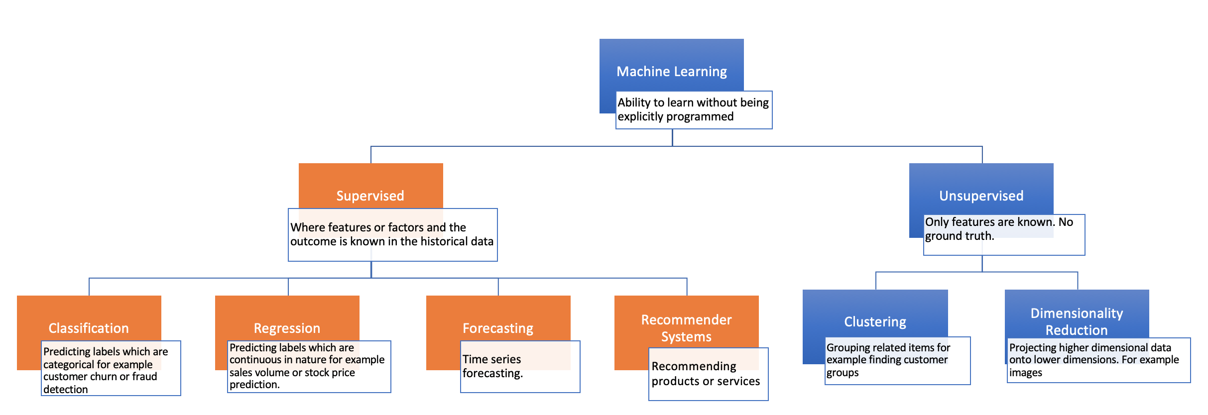
Machine Learning Algorithms
Notes:
Majority of the problem types are supervised learning problems.

Slide 3
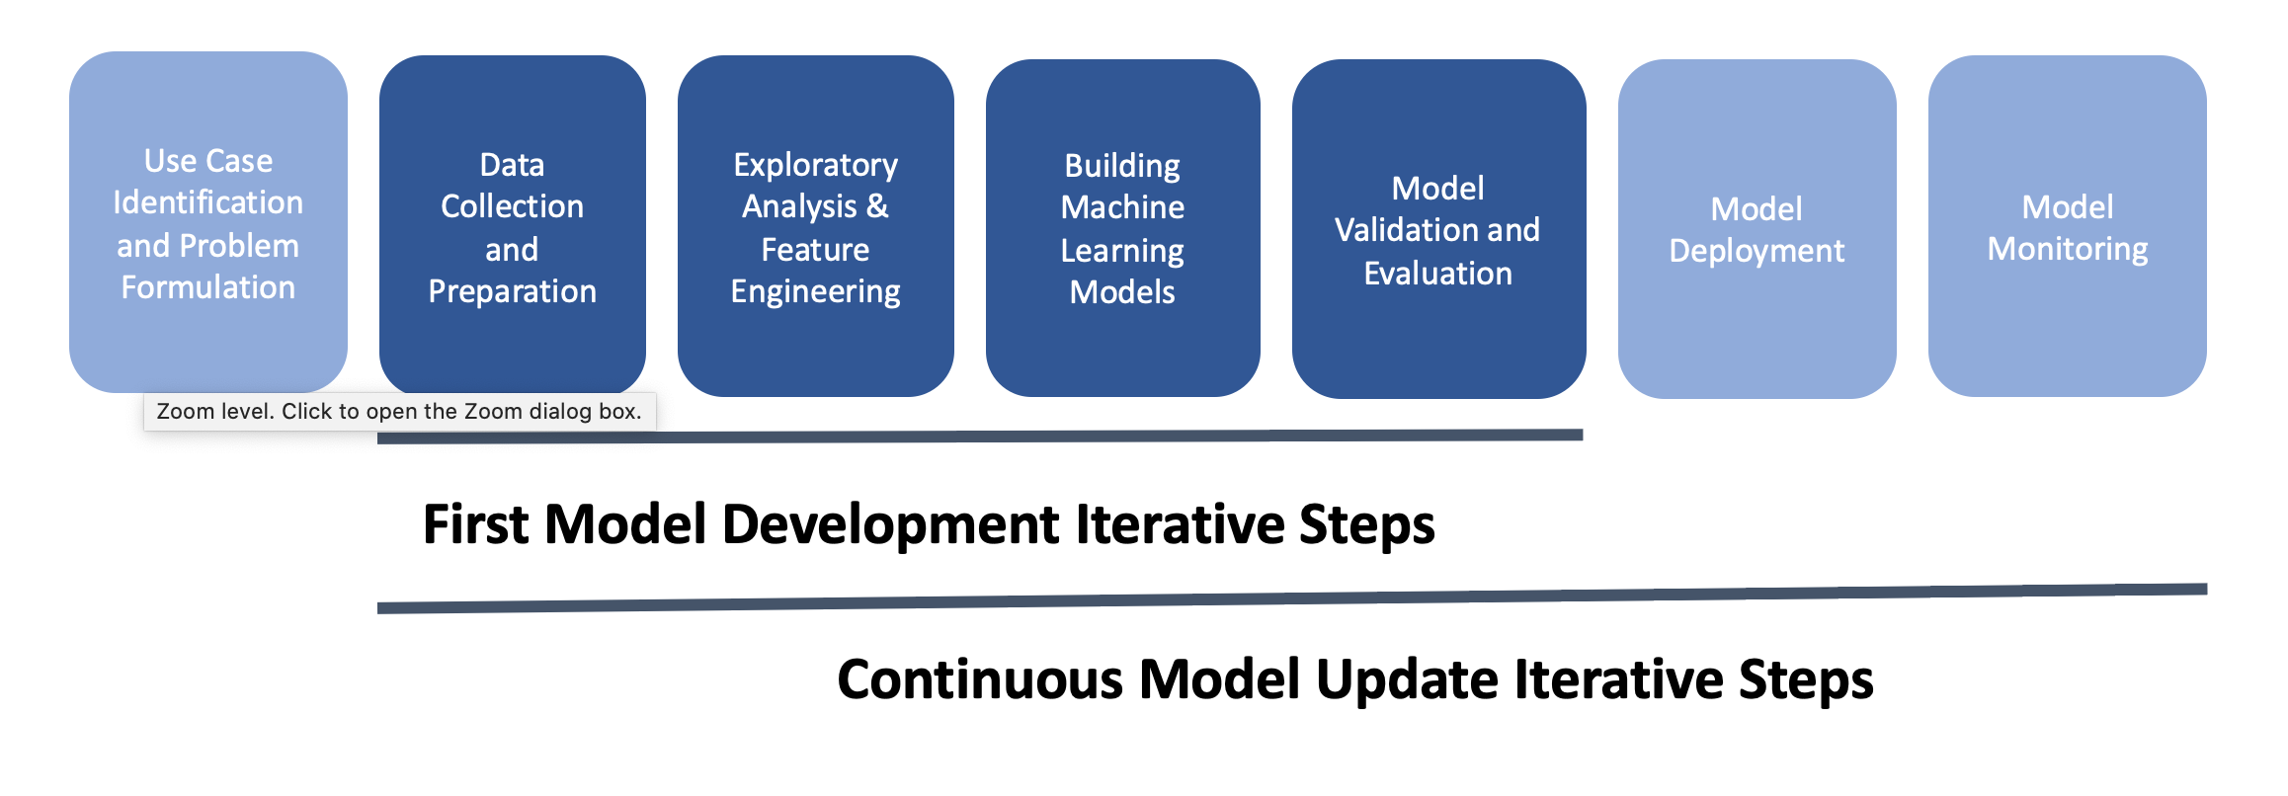
ML Lifecycle

Slide 4
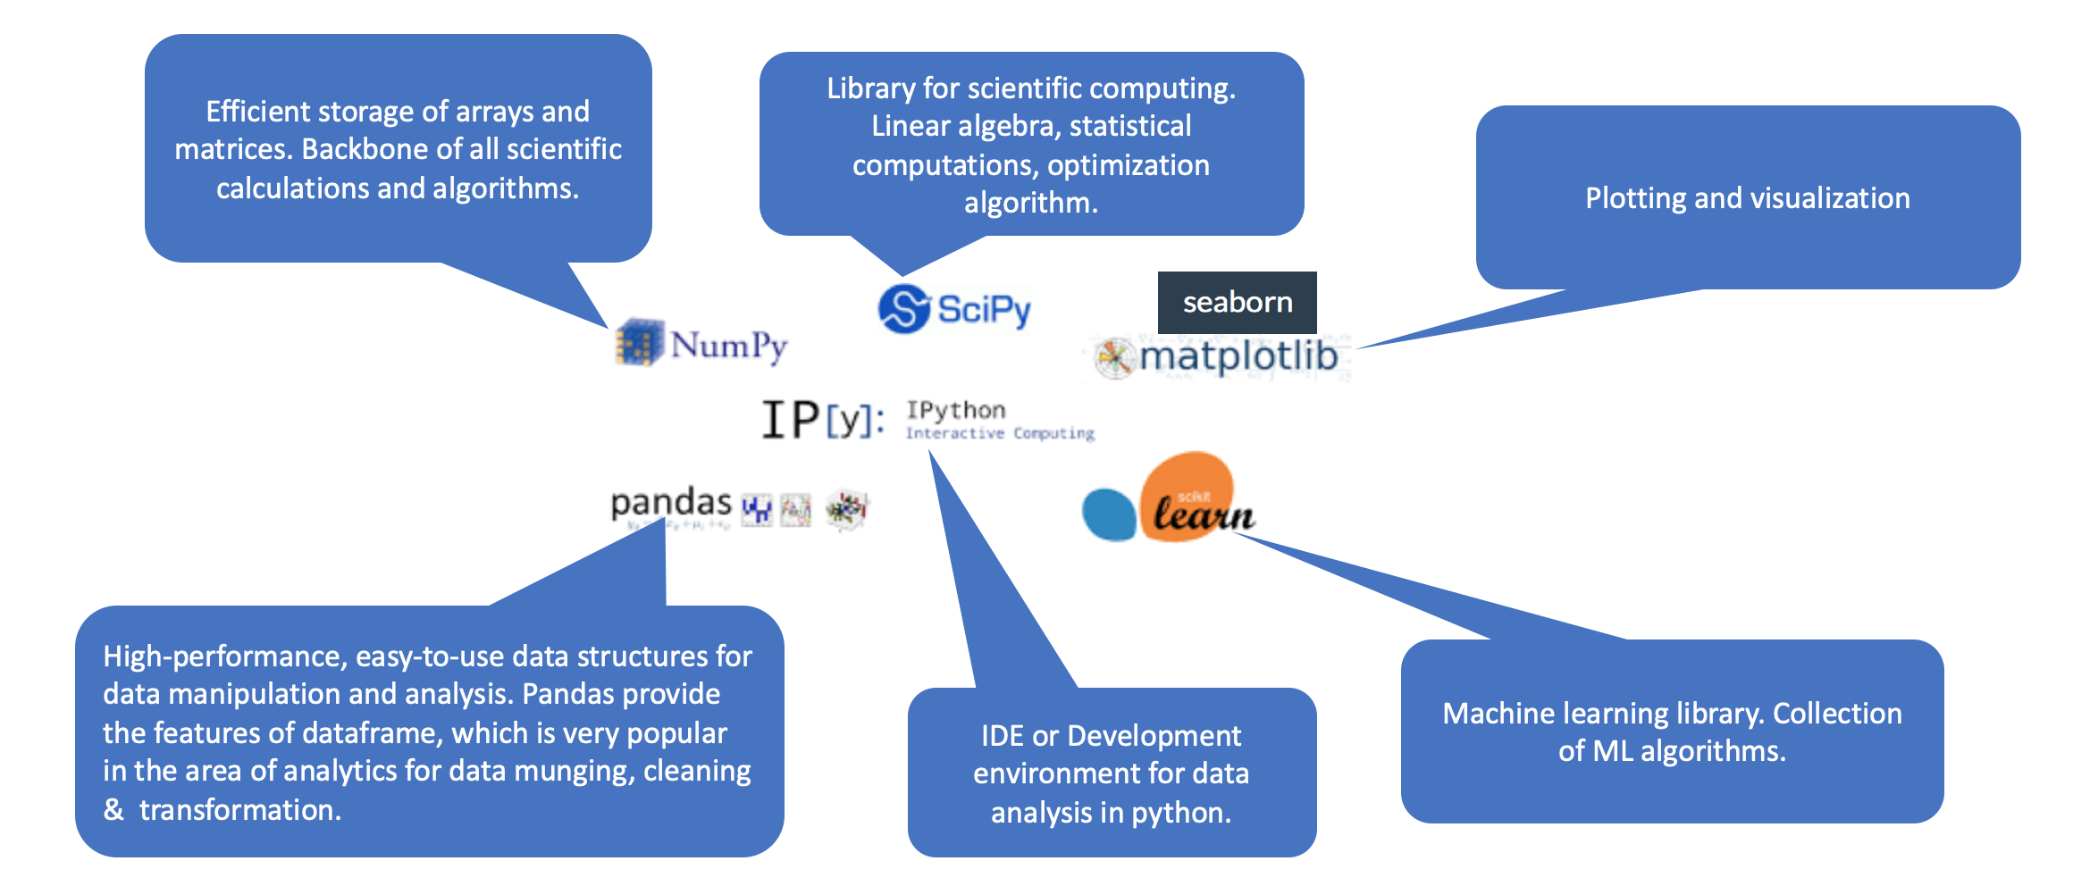
Python Stack For Data Science

Slide 5
ML SL-1: Day 2

Slide 7
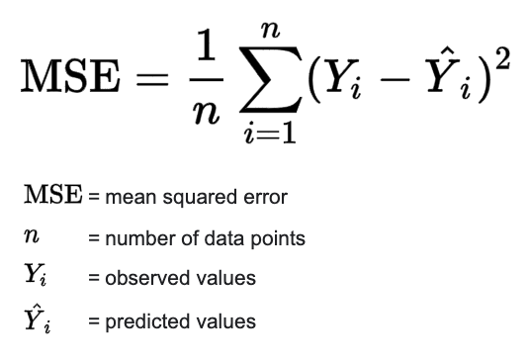
Regression: Loss Function

Slide 8
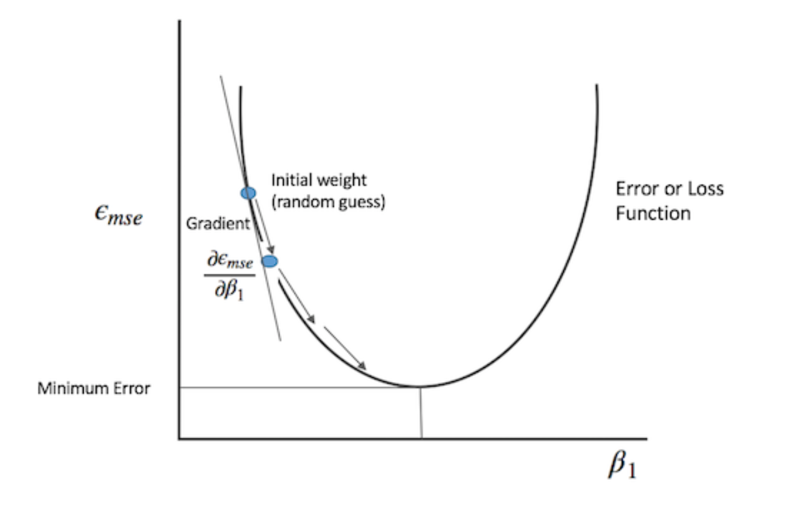

Gradient Descent

Slide 9
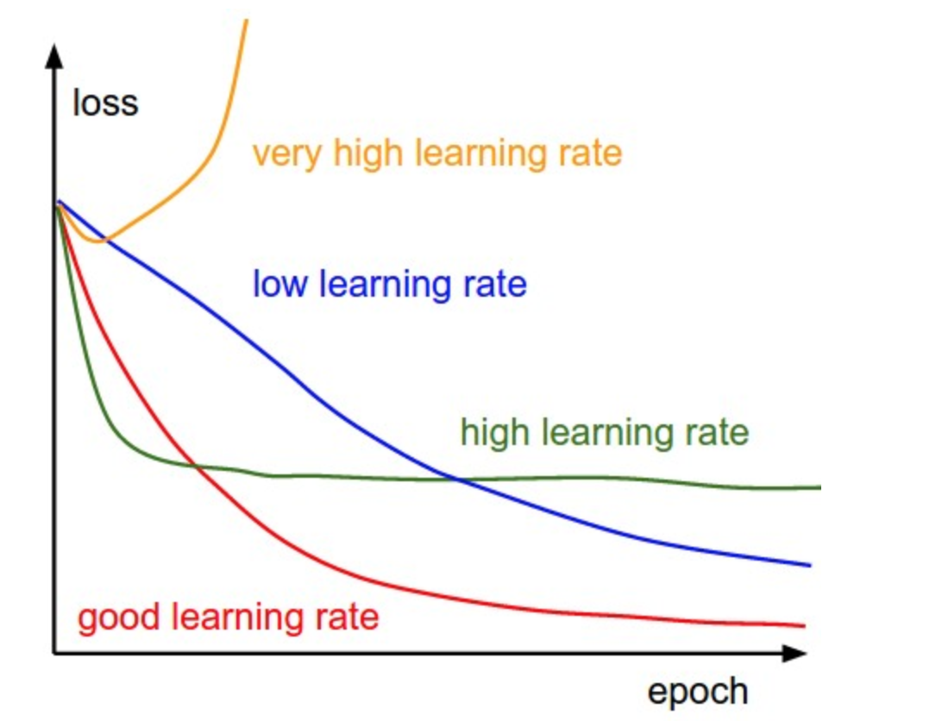
Learning Rate

Slide 10
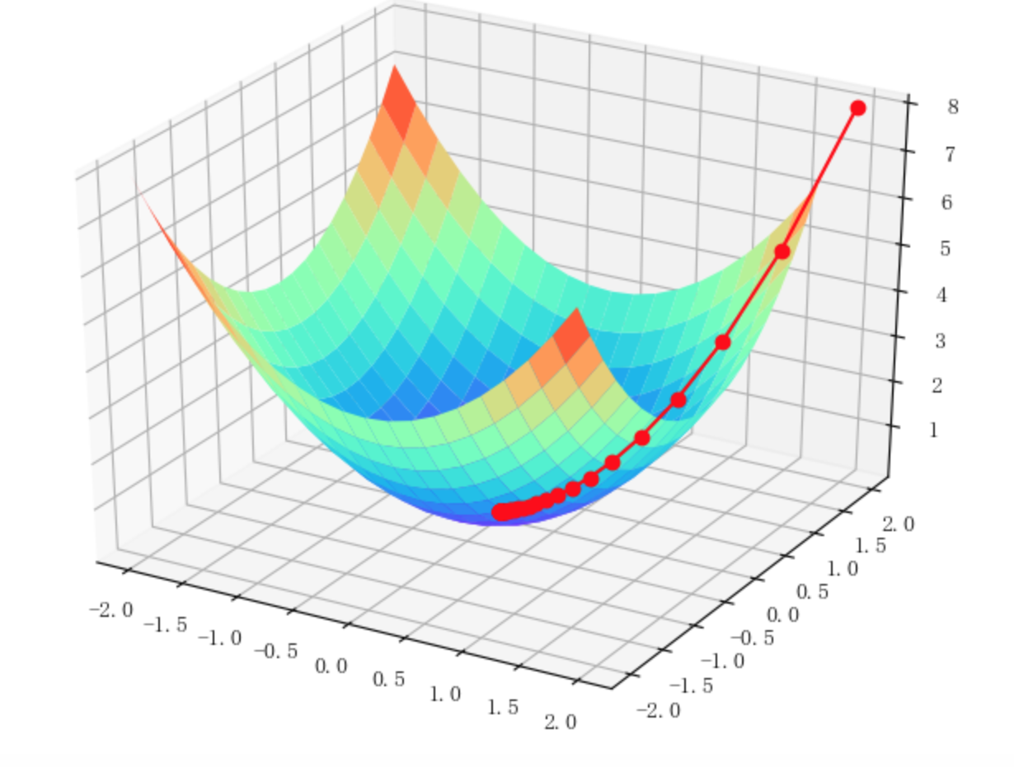
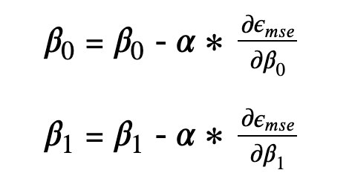
Gradient Descent

Slide 11
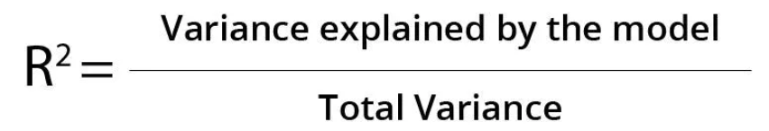
R Squared

Slide 12
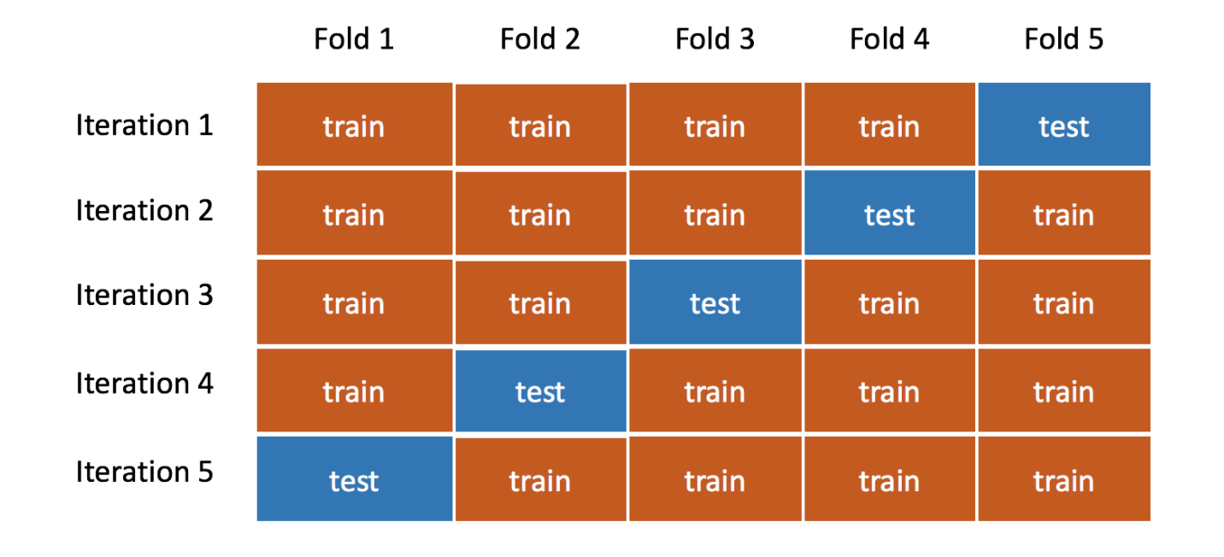
K-Fold Cross Validation

Slide 13
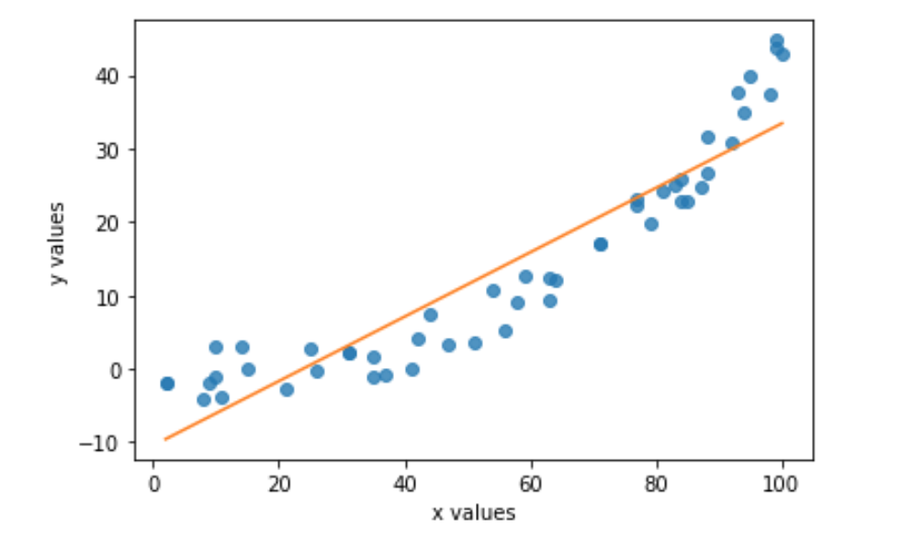

Bias – Variance Trade off

Slide 14
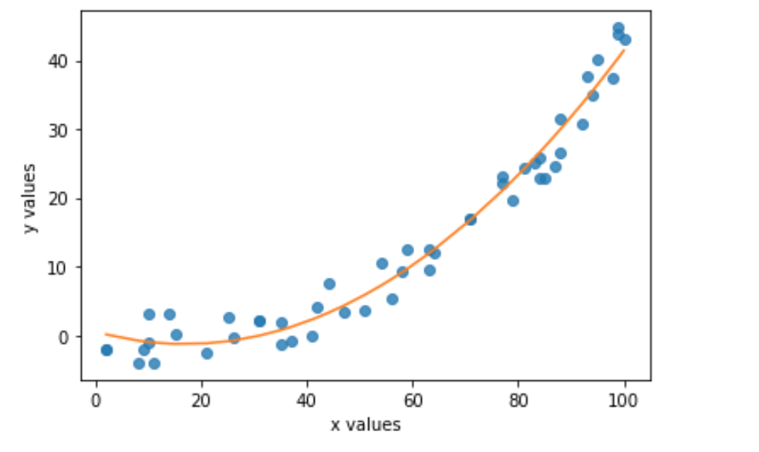

Bias – Variance Trade off

Slide 15
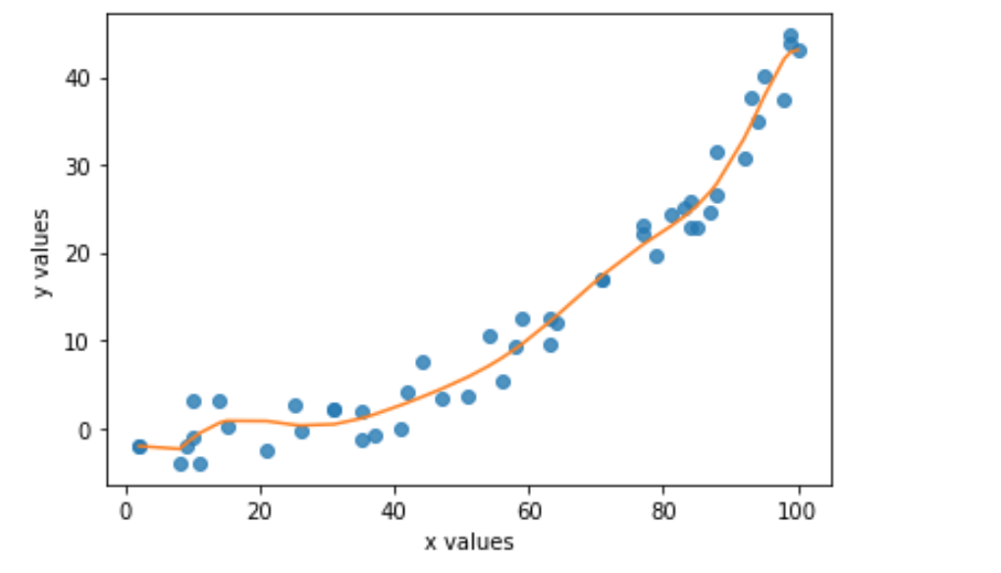
Bias – Variance Trade off

Slide 16
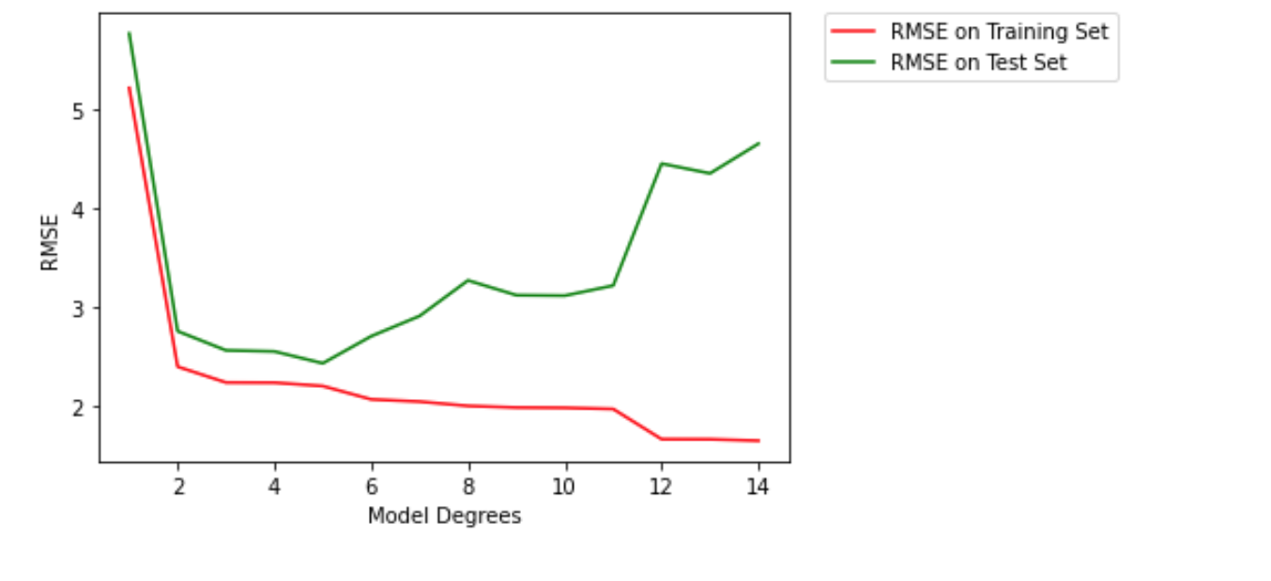
Bias – Variance Trade off

Slide 17
Regularization: Lasso & Ridge

Slide 18
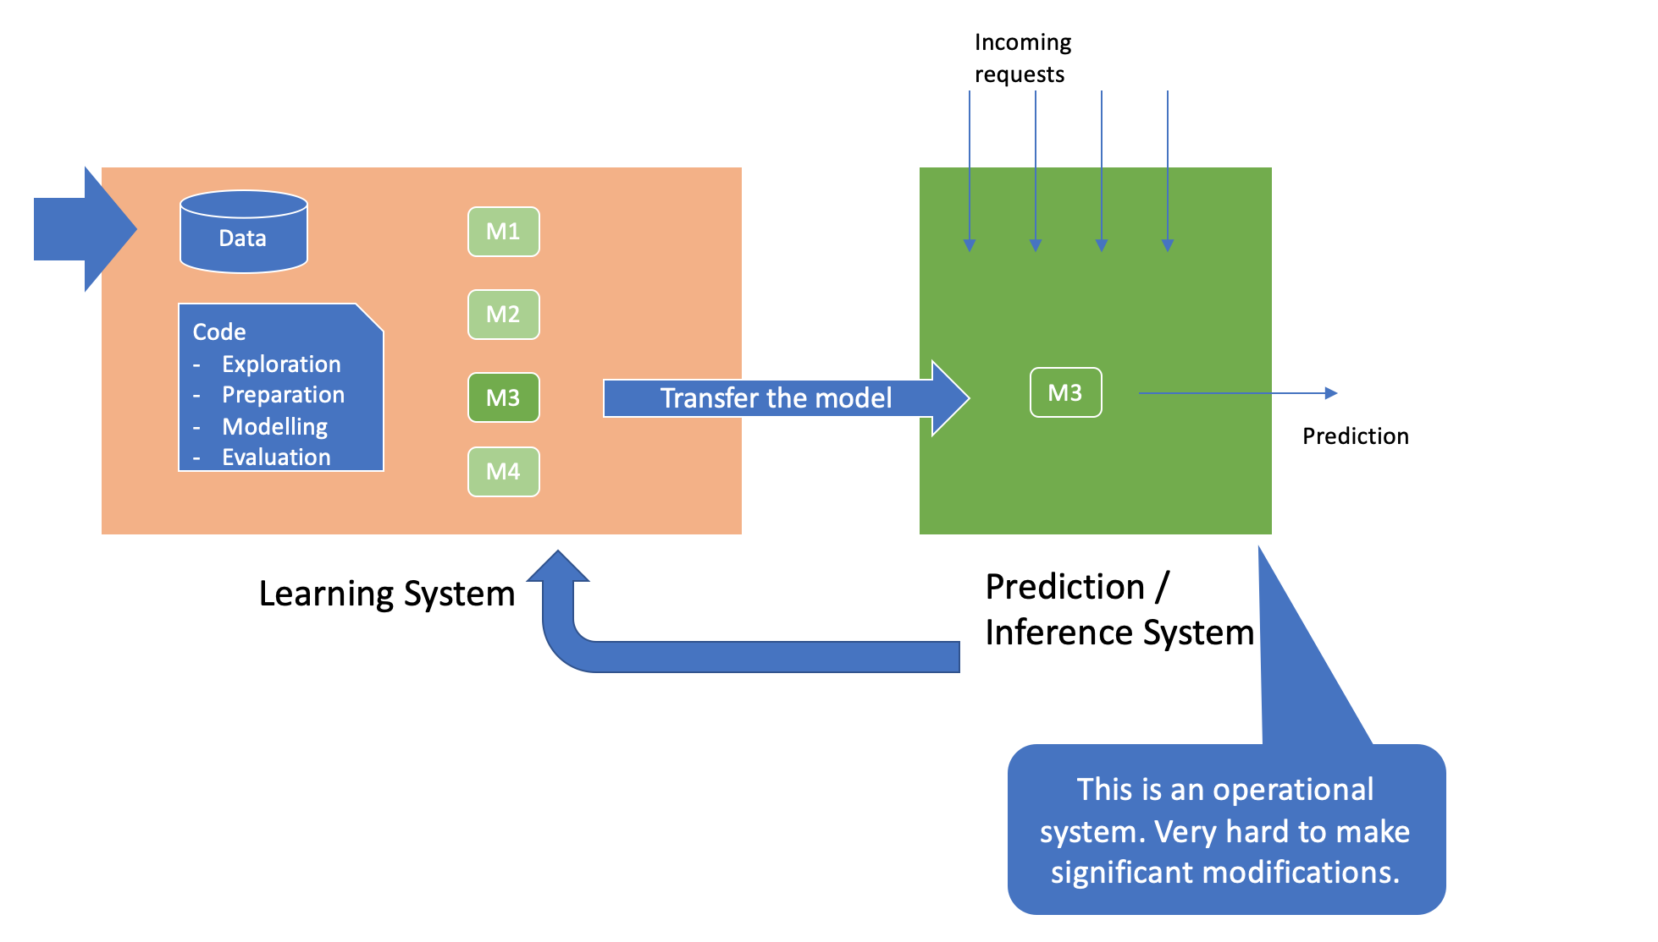
ML Systems
Notes:
Which all systems does the data come from?
How to take and integrate the model with the actual system. Model will run outside as a service or embed into the system.
What if the real time system has different requirements like latency / throughput? And the model inference time is not acceptable.
Training system environment is different than production system environment. And you can not alter the production environment. Highly risky.
How do we know the model is working right? Only accuracy measures?
User behavior changes over time. Do you redeploy when one user behavior changes?
New products are added to the catalog every time.
How do we know when to rebuild the model again?
Both the systems have different stakeholders and they have different objectives?

Slide 19
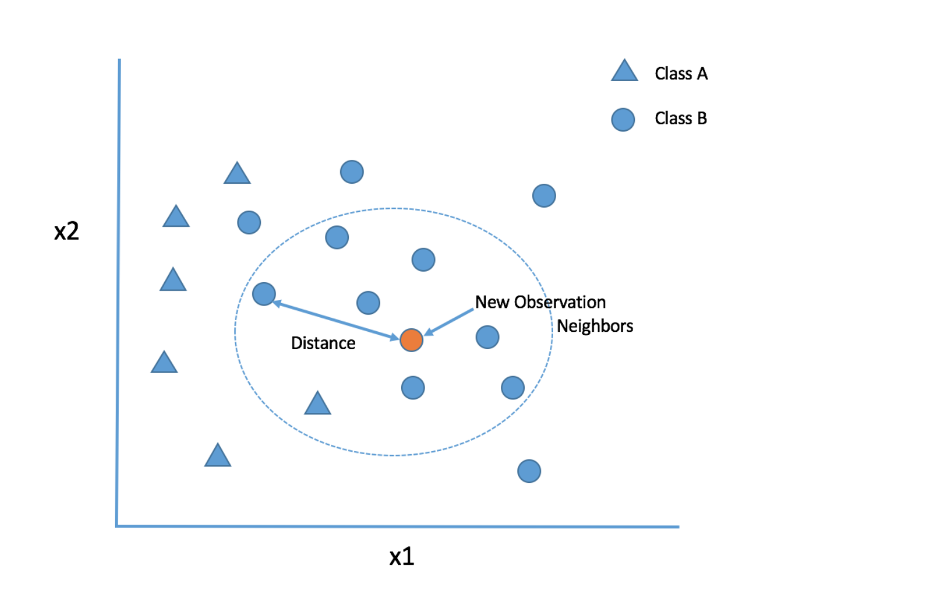
KNN

Slide 20

Euclidean Distance

Slide 21
Various Distance Calculations
Minkowski
Manhattan
Canberra
Jaccard
Dice
https://scikit-learn.org/stable/modules/generated/sklearn.neighbors.DistanceMetric.html

Slide 22
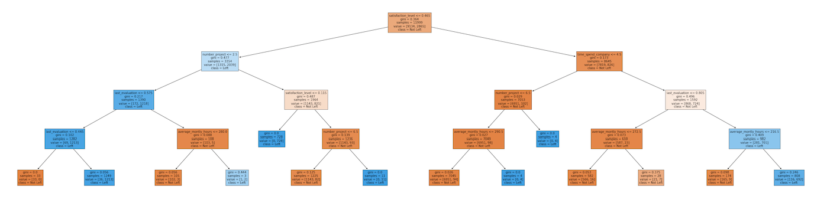
Decision Tree

